Slide 1


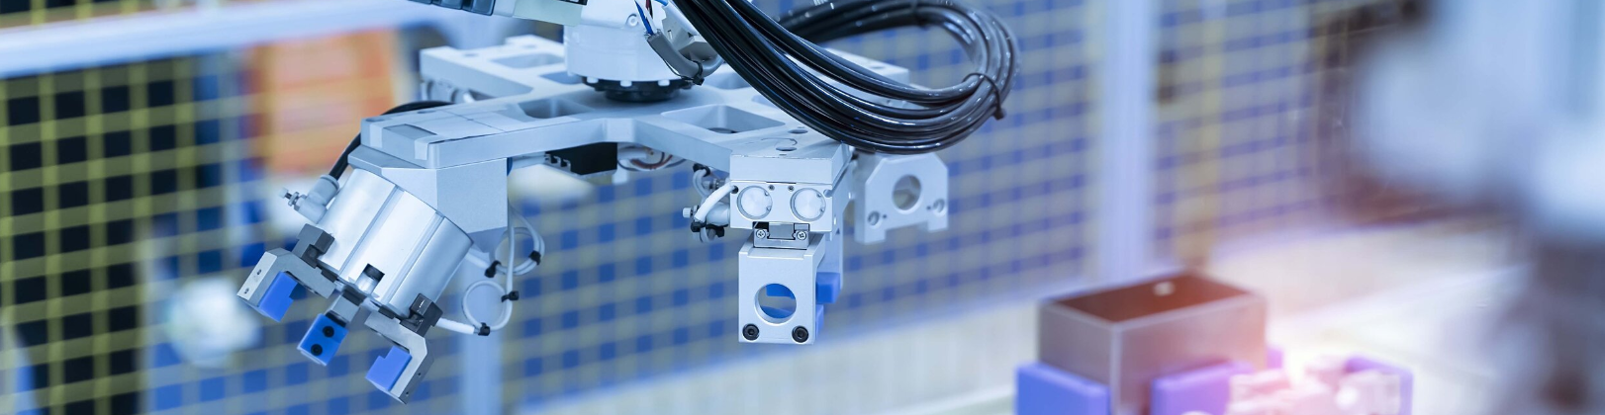
Topic Model 4
Design and Configuration of Automated Production Systems using Virtual Environments
Group
Yuhang Jiang
Saad Raza Hussain Shafi
June 11, 2024

Slide 2

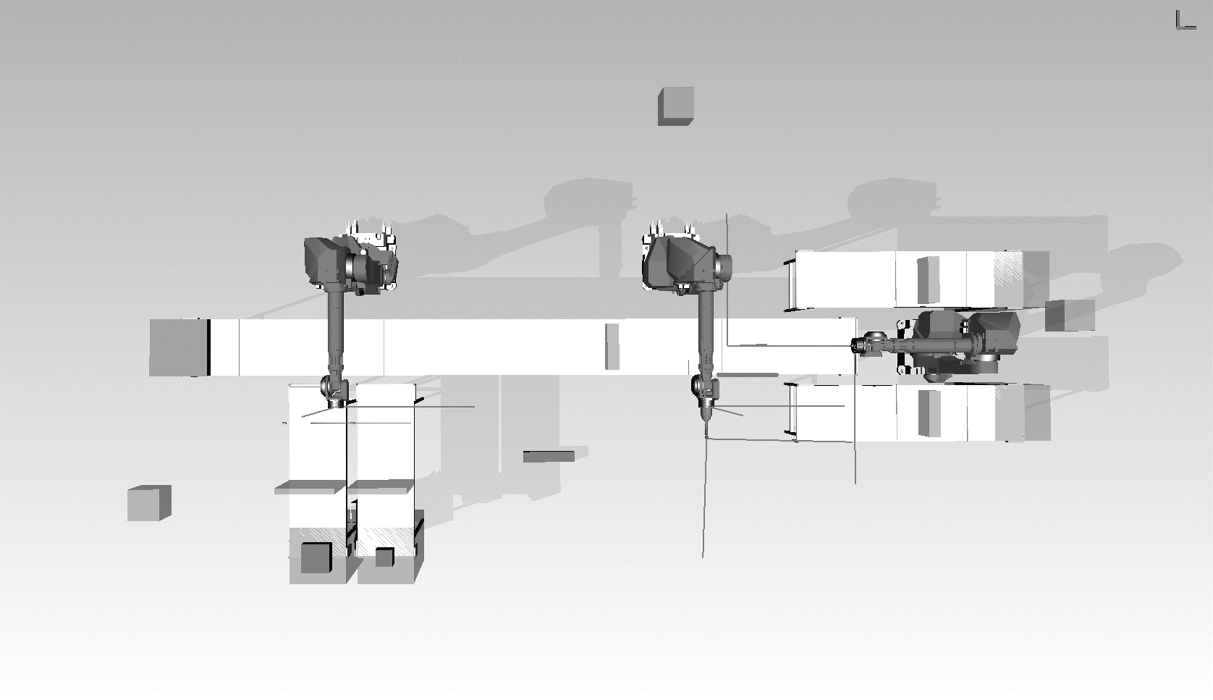
Robot Control Part
How Do Robots Perform on Conveyors?

Slide 3
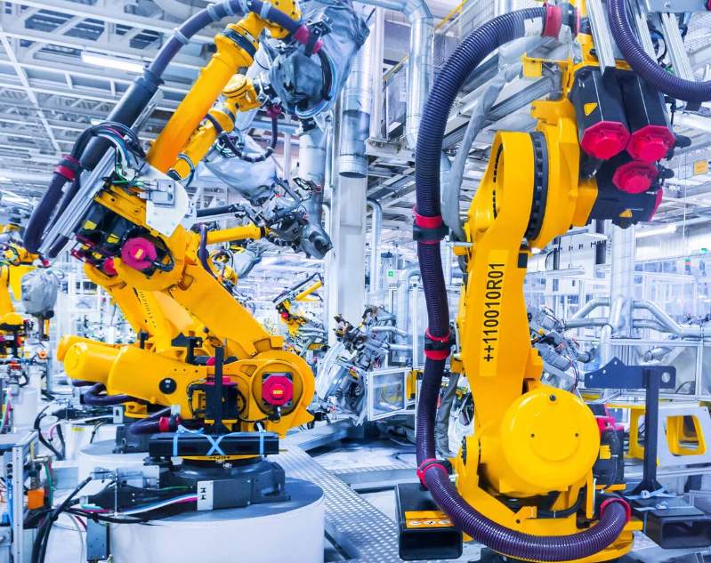
Robot Control Part
PL1StateMacheine.java (R1)
Assign variant to box A in the order of 2V1, 1V2, and 2V3, then take B and C from conveyor B and C respectively to assemble V1 (ABB), V2 (ABC), and V3 (ACC).
PL1StateMacheine1.java (R2)
Perform welding work for V1, V2, and V3.
PL1StateMacheine.java (R3)
Perform product sorting, placing V1 and V2 on conveyor belt D and placing V3 on conveyor belt E.

Slide 4
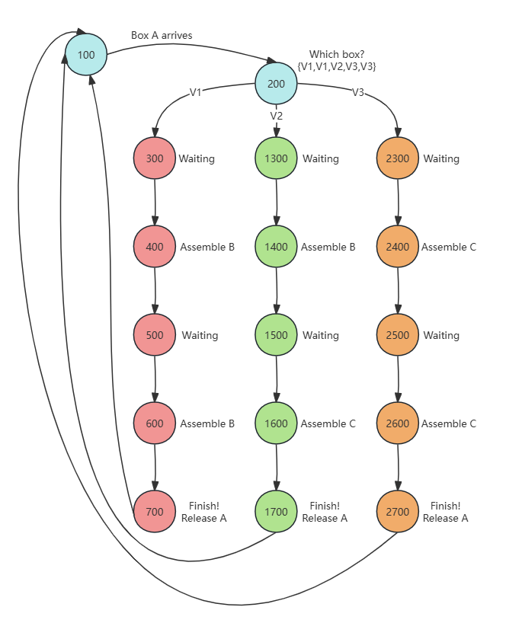
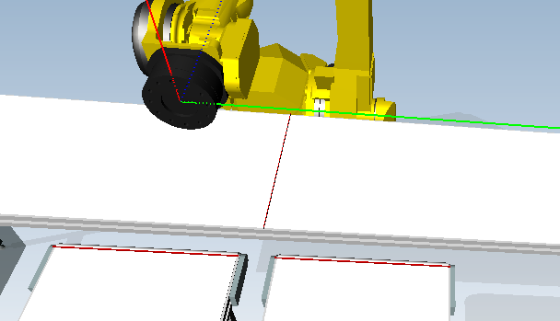
Robot Control Part
PL1StateMacheine.java (R1)
Three sensors
cA1Sen: Stop the box A, trigger R1 to get B/C
cBSen: Stop the box B, tell R1 B is ready.
cCSen: Stop the box C, tell R1 B is ready.
cA1Sen
cBSen
cCSen

Slide 5
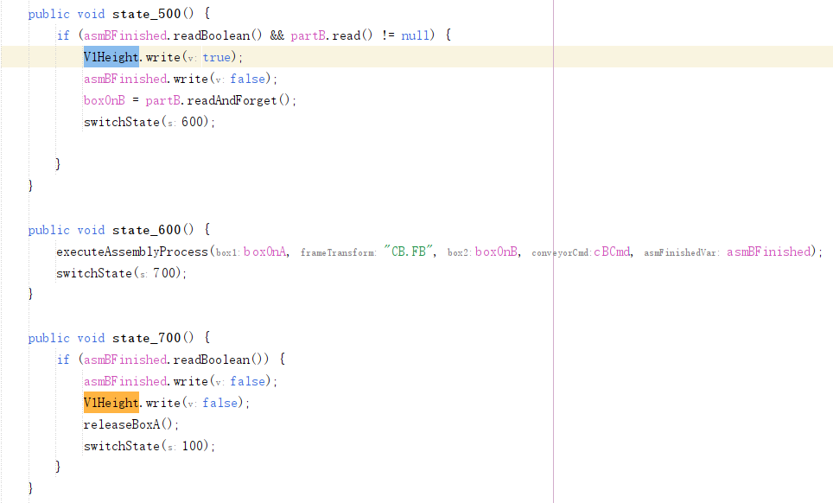
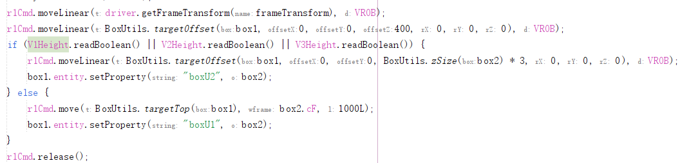
Robot Control Part
PL1StateMacheine.java (R1)
Challenge:
How to prevent a robot from overlapping with the first box when placing the second box?
Solution:
‘VxHeight’ is a boolean variable used to control the height adjustment of the robot when placing the second box. Specifically, V1Height acts as a flag indicating whether a height adjustment is necessary to avoid overlap in V1.

Slide 6
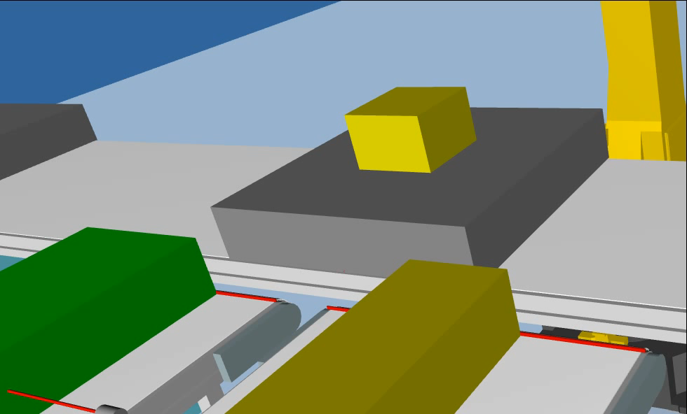
Robot Control Part

Slide 7
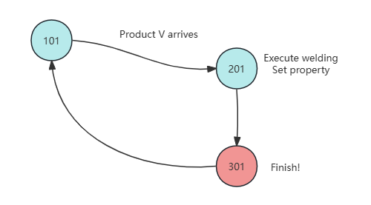
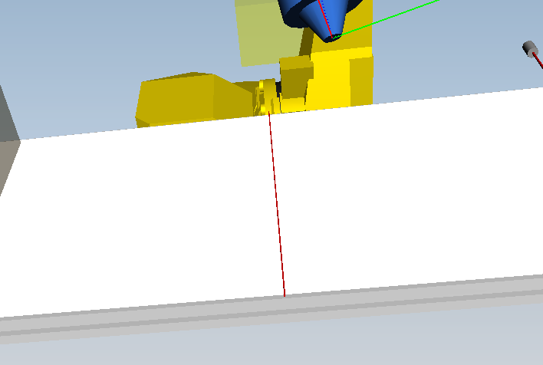
Robot Control Part
PL1StateMacheine1.java (R2)
One sensor
cA2Sen: Stop the Vx, trigger R2 to start welding.
cA2Sen

Slide 8
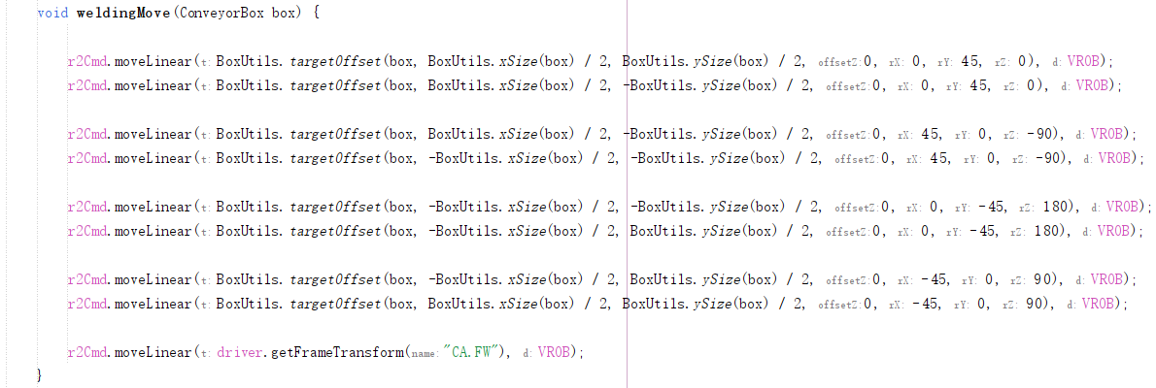
Robot Control Part
PL1StateMacheine1.java (R2)
Challenge:
How to make the welding gun move naturally along the connected edges while in motion?
Solution:
Adjust the welding gun direction only at turning points.
Don’t change the direction. Only linear move.
Don’t move. Only adjust the direction.

Slide 9
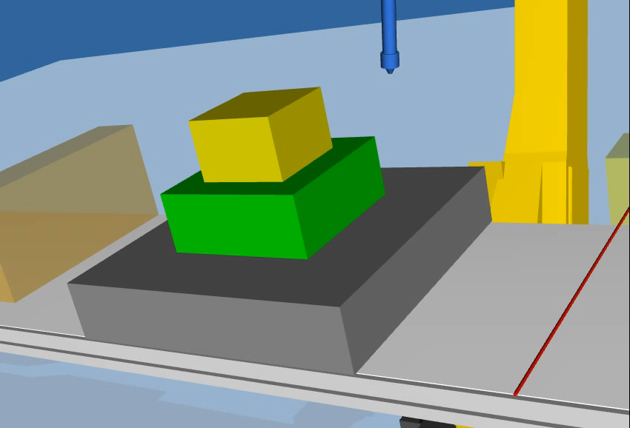
Robot Control Part

Slide 10
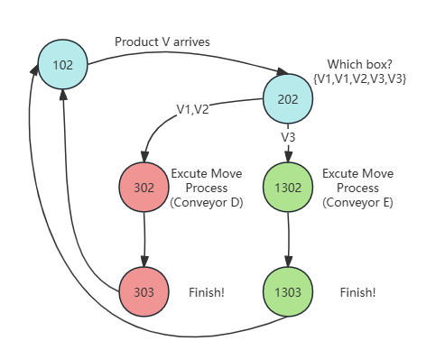
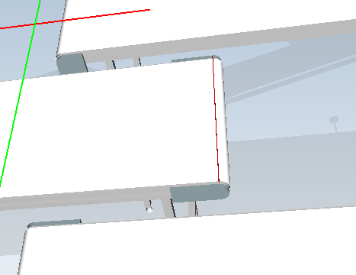
Robot Control Part
PL1StateMacheine2.java (R3)
One sensor
cA3Sen: Stop the Vx, trigger R3 to sort.
cA3Sen

Slide 11
Data Visualization Part
Production Stats

Slide 12
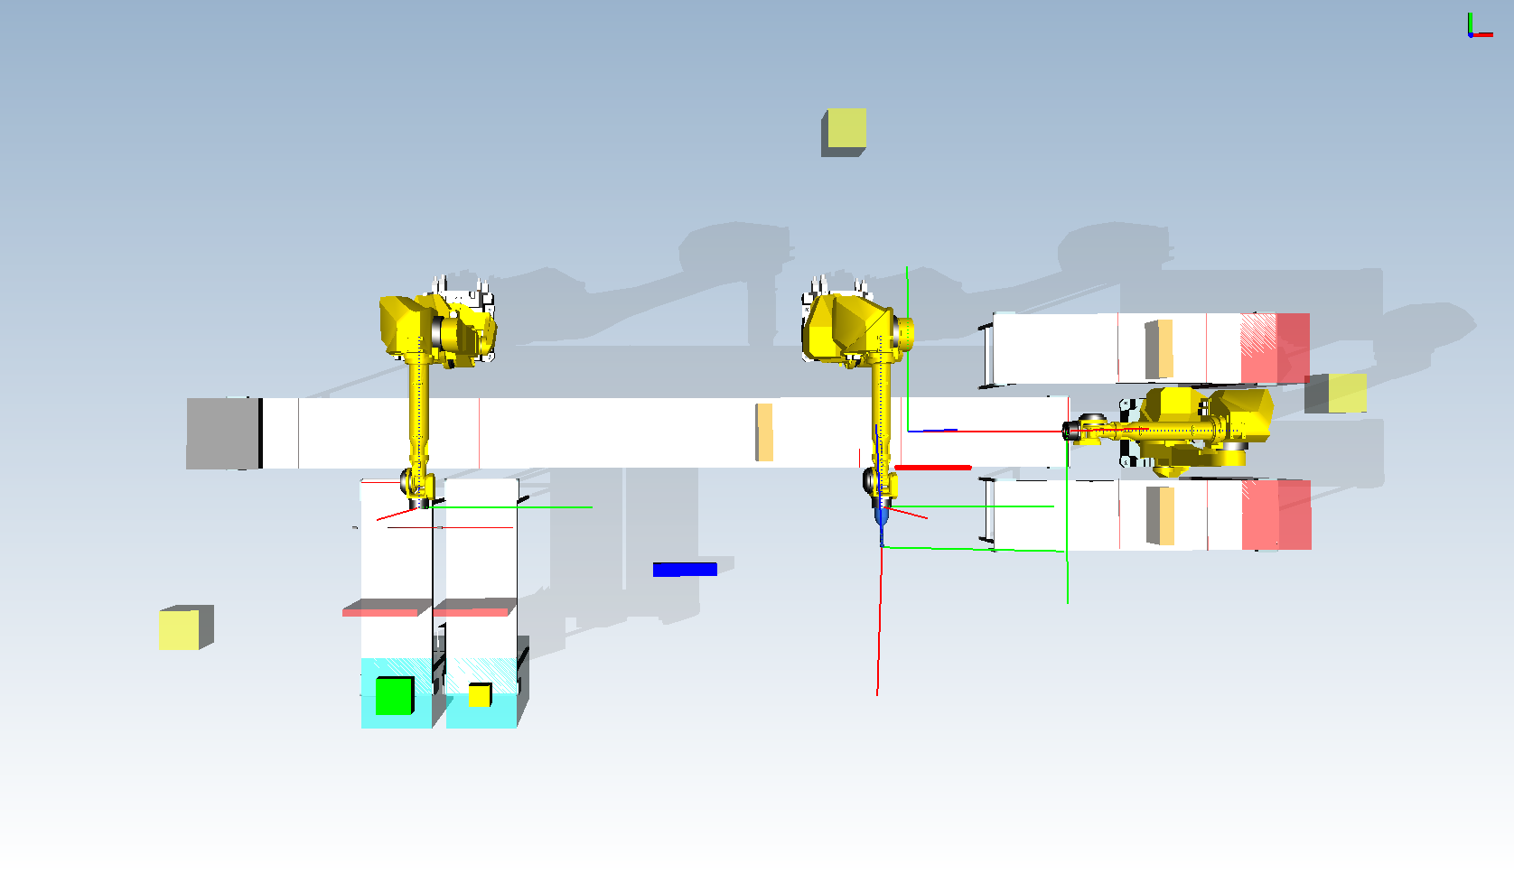
Data Visualization Part
How much parts are being produced?
How much parts are being scraped?
Which and How many by Variants?

Slide 13
Data Visualization Part
How much parts are being produced?
By counting the number of Parts A, B, C using Photocells on Conveyor A, B, and C
How much parts are being scraped?
Which and How many by Variants?

Slide 14
Data Visualization Part
How much parts are being produced?
By counting the number of Parts A, B, C using Photocells on Conveyor A, B, and C
How much parts are being scraped?
Counting the Parts being scrapped in 10minutes using Photocells
Which and How many by Variants?

Slide 15
Data Visualization Part
How much parts are being produced?
By counting the number of Parts A, B, C using Photocells on Conveyor A, B, and C
How much parts are being scraped?
Counting the Parts being scrapped in 10minutes using Photocells
Which and How many by Variants?
Counting the products(welded boxes) using RFIDs and “variant”

Slide 16
Data Visualization Part
What’s Happening on Conveyors?

Slide 17
Data Visualization Part
How fast assembly is being done?
How fast Welding is being done?
Which Variant is on the Main Conveyor?
Are the Conveyor B and C crowded?

Slide 18
Data Visualization Part
How fast assembly is being done?
By counting the number of assembled Parts in 10 min using Photocells after R1
How fast Welding is being done?
By counting the number of welded Parts in 10 min using Photocells after R1
Which Variant is on the Main Conveyor?
By using RFID to detect the current variant going for welding
Are the Conveyor B and C crowded?
By using Distance Sensor to detect the crowdedness on these Conveyors

Slide 19
Data Visualization Part
How fast assembly is being done?
By counting the number of assembled Parts in 10 min using Photocells after R1
How fast Welding is being done?
By counting the number of welded Parts in 10 min using Photocells after R1
Which Variant is on the Main Conveyor?
By using RFID to detect the current variant going for welding
Are the Conveyor B and C crowded?
By using Distance Sensor to detect the crowdedness on these Conveyors

Slide 20
Data Visualization Part
How fast assembly is being done?
By counting the number of assembled Parts in 10 min using Photocells after R1
How fast Welding is being done?
By counting the number of welded Parts in 10 min using Photocells after R1
Which Variant is on the Main Conveyor?
By using RFID to detect the current variant going for welding
Are the Conveyor B and C crowded?
By using Distance Sensor to detect the crowdedness on these Conveyors

Slide 21
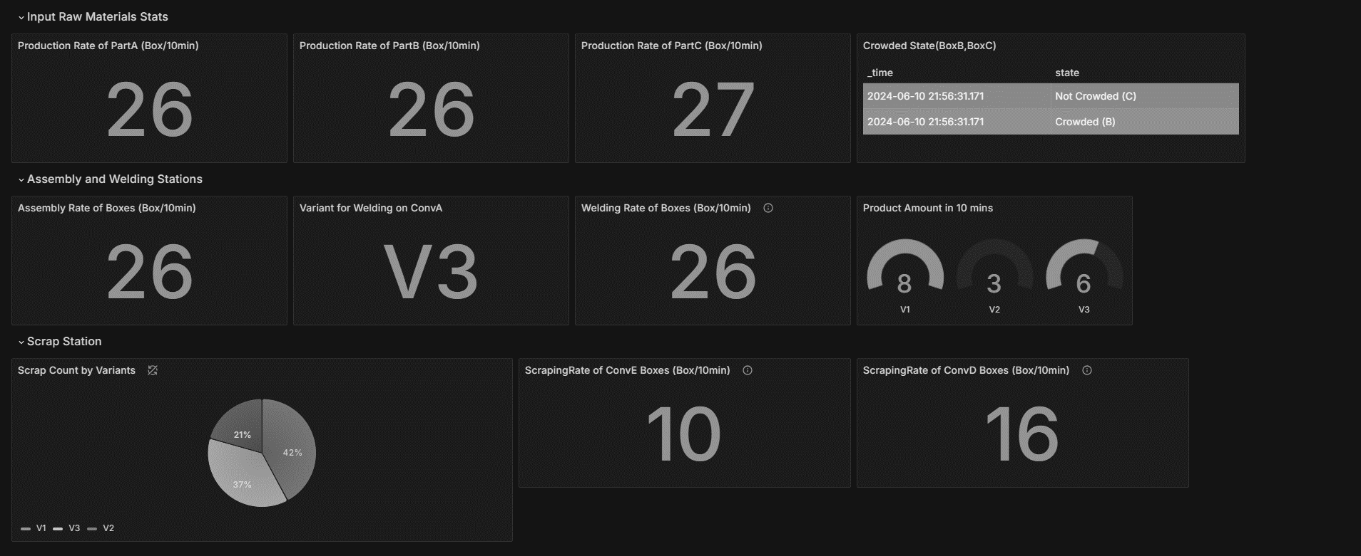
Data Visualization Part
Dashboard

Slide 22
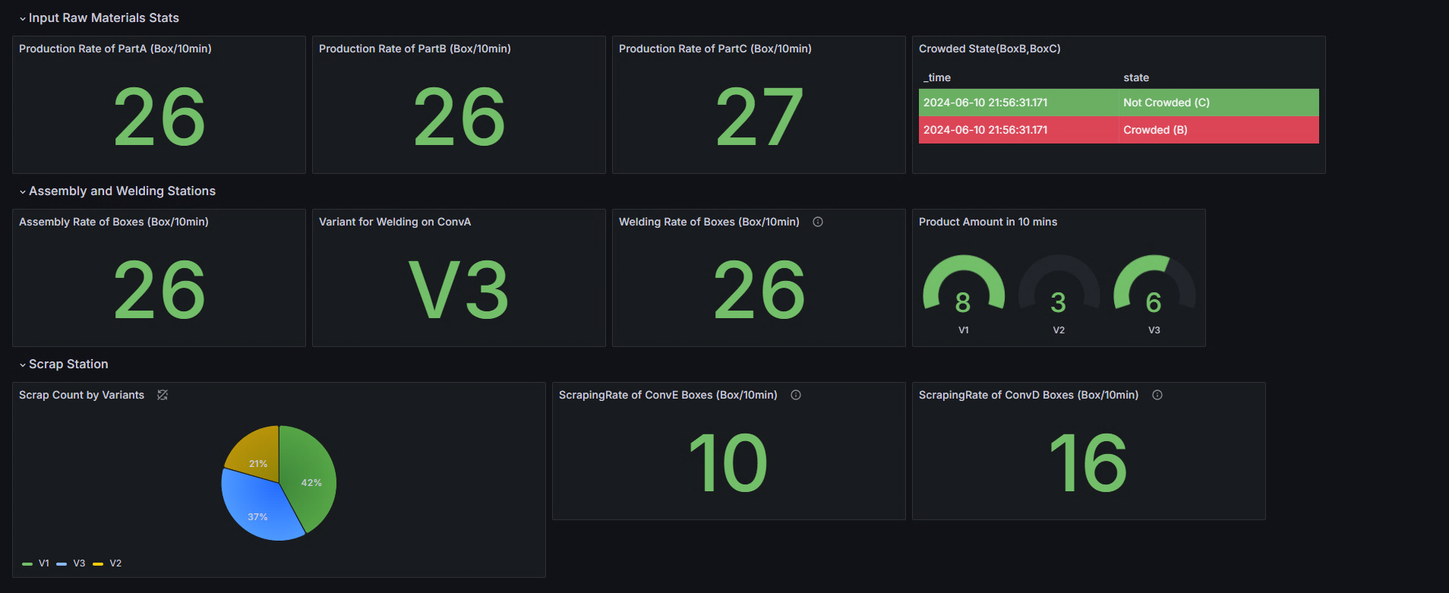
Data Visualization Part

Slide 23
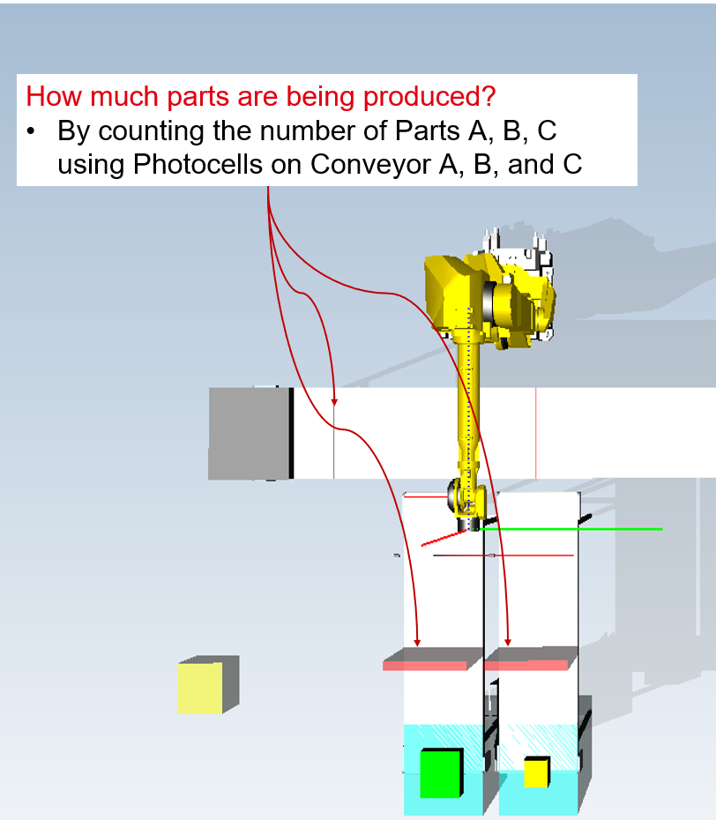
Data Visualization Part

Slide 24
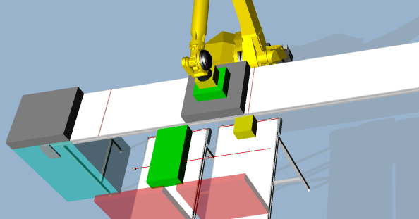
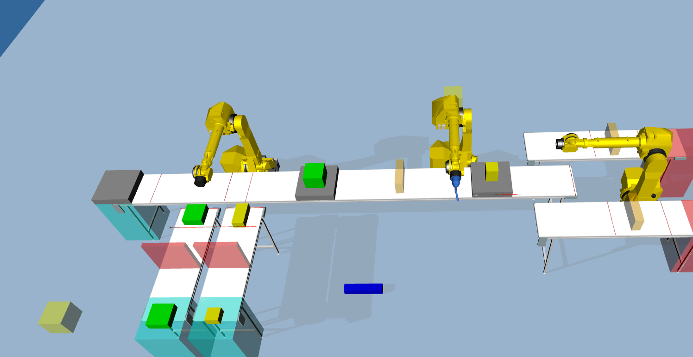
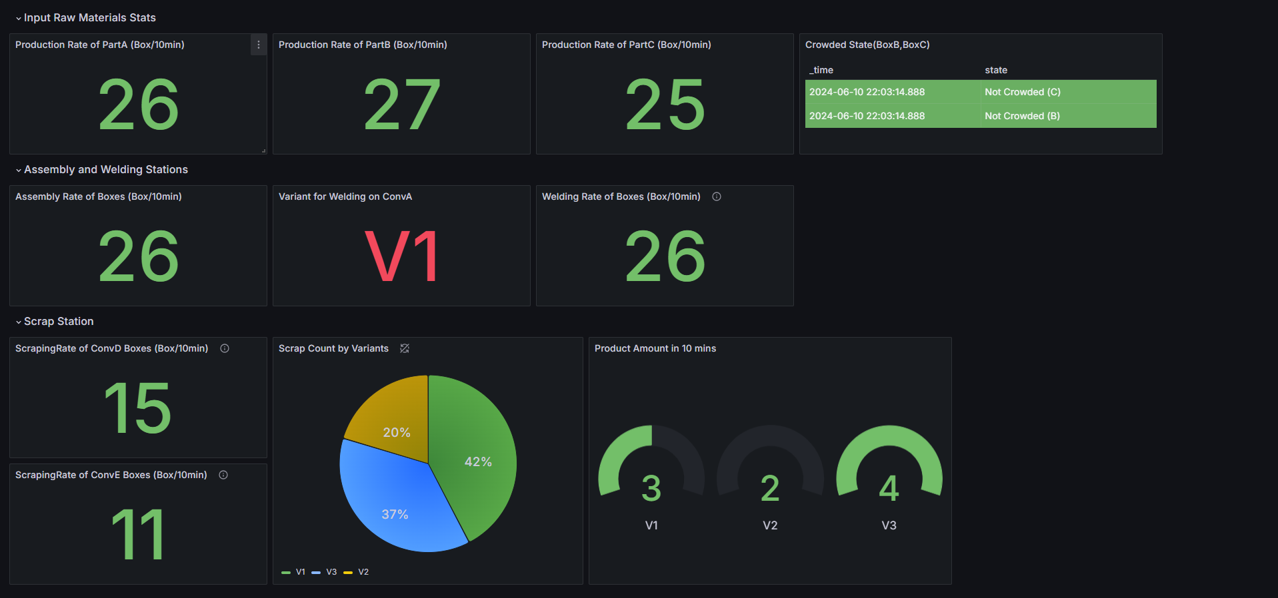
Data Visualization Part

Slide 25
Data Visualization Part

Slide 26
Data Visualization Part
How fast assembly is being done?
By counting the number of assembled Parts in 10 min using Photocells after R1
How fast Welding is being done?
By counting the number of welded Parts in 10 min using Photocells after R1
Which Variant is on the Main Conveyor?
By using RFID to detect the current variant going for welding
Total Variants Produced in the last 10 minutes?
By using Distance Sensor to detect the crowdedness on these Conveyors

Slide 27
Data Visualization Part

Slide 28
Data Visualization Part
Data Visualization Part

Slide 29
Data Visualization Part
Which and How many by Variants?
Counting the products(welded boxes) using RFIDs and “variant”
How much parts are being scraped?
Counting the Parts being scrapped in 10minutes using Photocells

Slide 30
Data Visualization Part

Slide 31
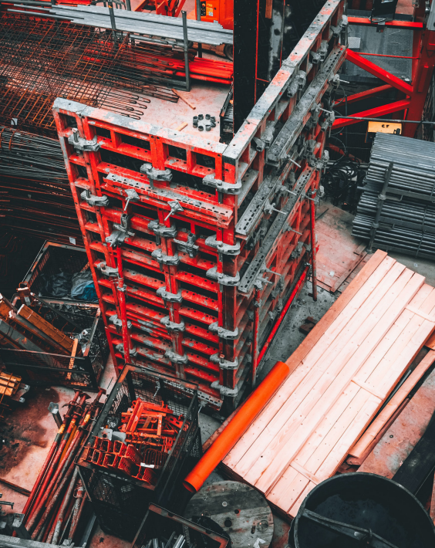
Thank you for your attention.

